Slide 1

DATA ENGINEERING 2
CHAPTER 4
Laszlo Sallo
OCTOBER 2020

Slide 2
NOSQL CLASSIFICATION
KEY-VALUE STORES
TIME SERIES DBMS
DOCUMENT STORES
COLUMN STORES
GRAPH DBMS
SEARCH ENGINES

Slide 3
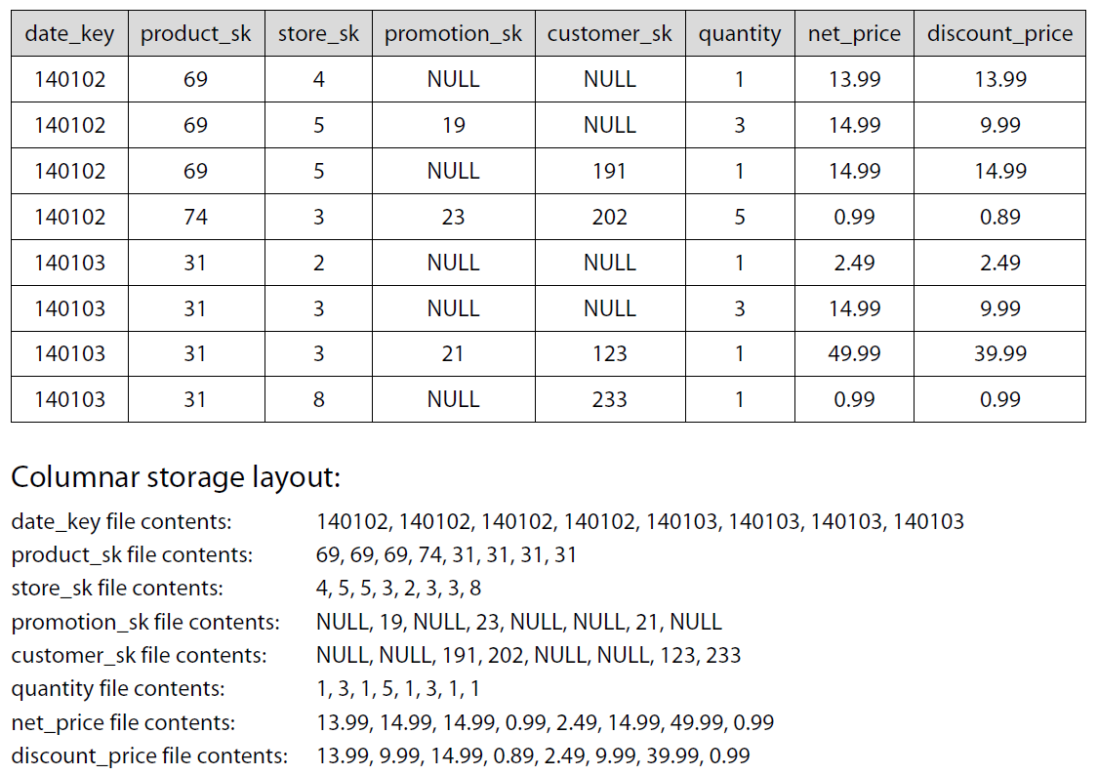
CLASSICAL DATA TABLE
140102 69 4 NULL NULL 1 13.99 13.99 140102 69 5 19 NULL 3 14.99 9.99 140102 69 5 NULL 191 1 14.99 14.99 140102 74 3 23 202 5 0.99 0.89 140103 31 2 NULL NULL 1 2.49 2.49 140103 31 3 NULL NULL 3 14.99 9.99 140103 31 3 21 123 1 49.99 39.99 140103 31 8 NULL 233 1 0.99 0.99
DISCOUNT PRICES FOR LAST DAY ?

Slide 4
WIDE COLUMN STORES

Slide 5
COMPARE DISK ACCESS
CLASSICAL TABULAR DATA
140102 69 4 NULL NULL 1 13.99 13.99 140102 69 5 19 NULL 3 14.99 9.99 140102 69 5 NULL 191 1 14.99 14.99 140102 74 3 23 202 5 0.99 0.89 140103 31 2 NULL NULL 1 2.49 2.49 140103 31 3 NULL NULL 3 14.99 9.99 140103 31 3 21 123 1 49.99 39.99 140103 31 8 NULL 233 1 0.99 0.99
WIDE COLUMN STORES
140102 140102 140102 140102 140103 140103 140103 140103 69 69 69 74 31 31 31 31 4 5 5 3 2 3 3 8 NULL 19 NULL 23 NULL NULL 21 NULL NULL NULL 191 202 NULL NULL 123 233 1 3 1 5 1 3 1 1 13.99 14.99 14.99 0.99 2.49 14.99 49.99 0.99 13.99 9.99 14.99 0.89 2.49 9.99 39.99 0.99

Slide 6
COMPRESSION
CLASSICAL TABULAR DATA
140102 69 4 NULL NULL 1 13.99 13.99 140102 69 5 19 NULL 3 14.99 9.99 140102 69 5 NULL 191 1 14.99 14.99 140102 74 3 23 202 5 0.99 0.89 140103 31 2 NULL NULL 1 2.49 2.49 140103 31 3 NULL NULL 1 14.99 9.99 140103 31 3 21 123 1 49.99 39.99 140103 31 8 NULL 233 1 0.99 0.99
WIDE COLUMN STORES
140102 140102 140102 140102 140103 140103 140103 140103 69 69 69 74 31 31 31 31 4 5 5 3 2 3 3 8 NULL 19 NULL 23 NULL NULL 21 NULL NULL NULL 191 202 NULL NULL 123 233 1 3 1 5 1 1 1 1 13.99 14.99 14.99 0.99 2.49 14.99 49.99 0.99 13.99 9.99 14.99 0.89 2.49 9.99 39.99 0.99

Slide 7
KEY FEAUTRES
FASTER ACCESS TIME WHEN YOU QUERY A FEW NEED DIMENSIONS
READ OPTIMIZED
HIGHLY SCALABLE BY DIMENSION
COMPRESSION
NEW GENERATION OF DW

Slide 8
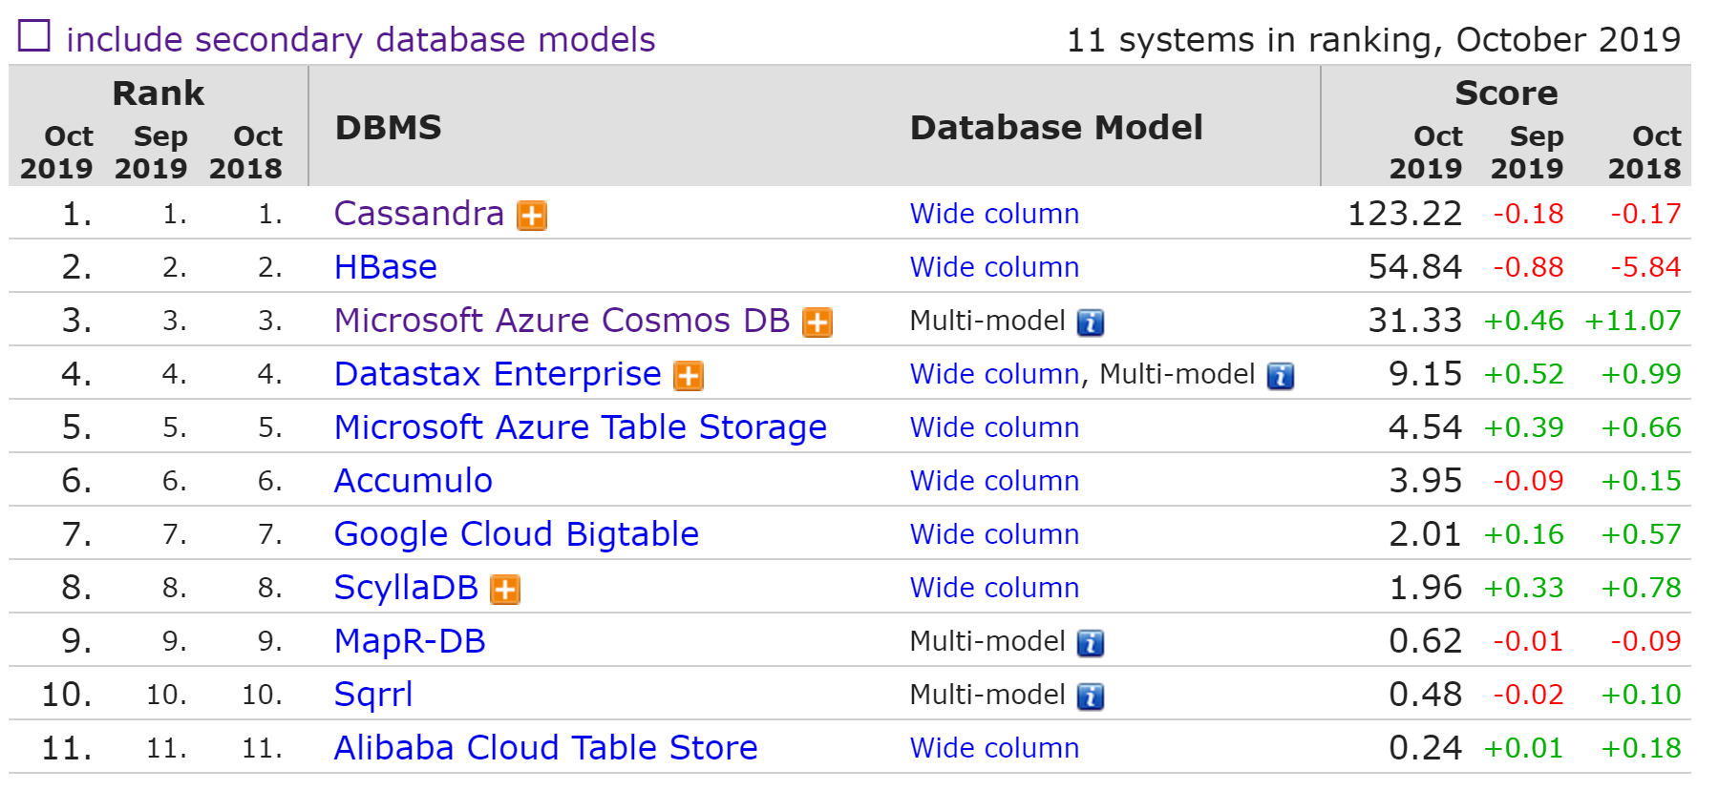
WIDE COLUMN STORE RANK

Slide 9

USE CASE – GOOGLE ANALYTICS

Slide 10
NOSQL CLASSIFICATION
KEY-VALUE STORES
TIME SERIES DBMS
DOCUMENT STORES
COLUMN STORES
SEARCH ENGINES
GRAPH DBMS

Slide 11



MANY BUILT-IN FUNCTIONS
Facet search
Text Analysis
Geospatial Search
+ Build your own

Slide 12
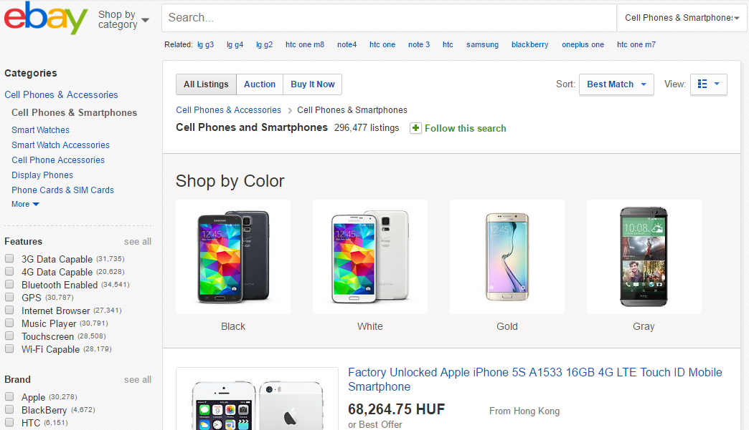
FACETED SEARCH

Slide 13
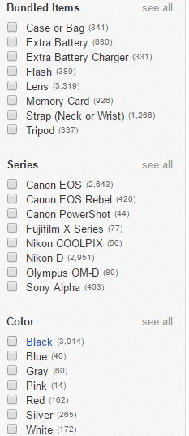
FACETED SEARCH
GUIDED QUERIES
E-COMMERCE: GUIDE YOUR CUSTOMERS
ANALYTICS: SLICING AND DICING, SELF SERVICE BI

Slide 14
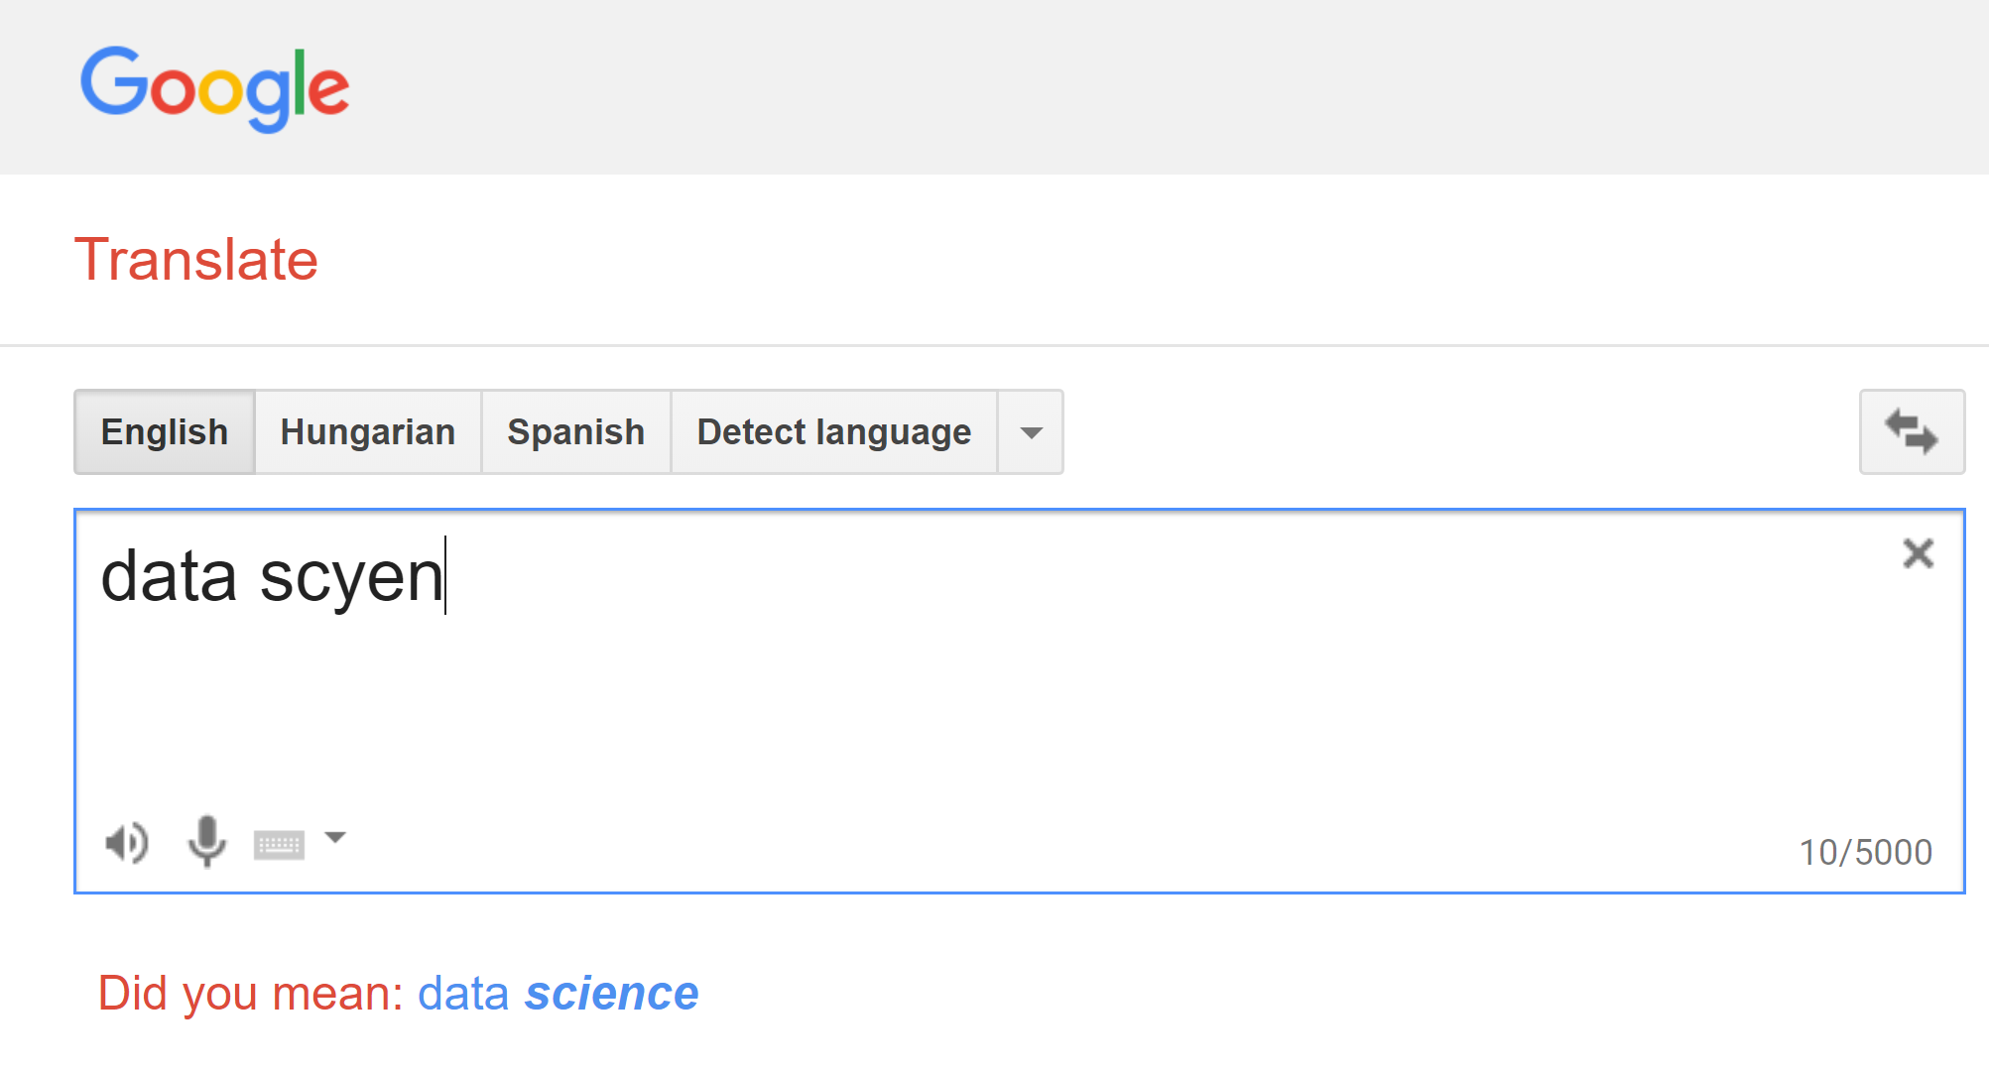
TEXT FUNCTIONS

Slide 15
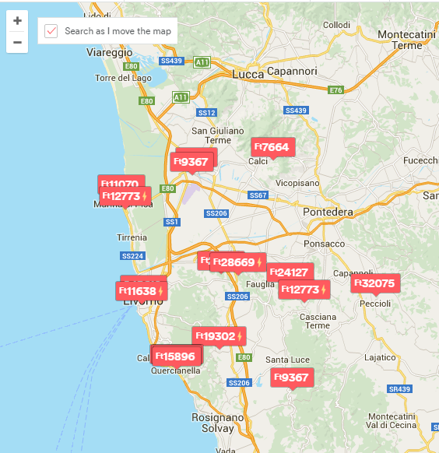
GEOSPATIAL SEARCH
COORDINATES TO EACH RECORD
QUERY:
AREA BY DIFFERENT SHAPES
PROXIMITY

Slide 16
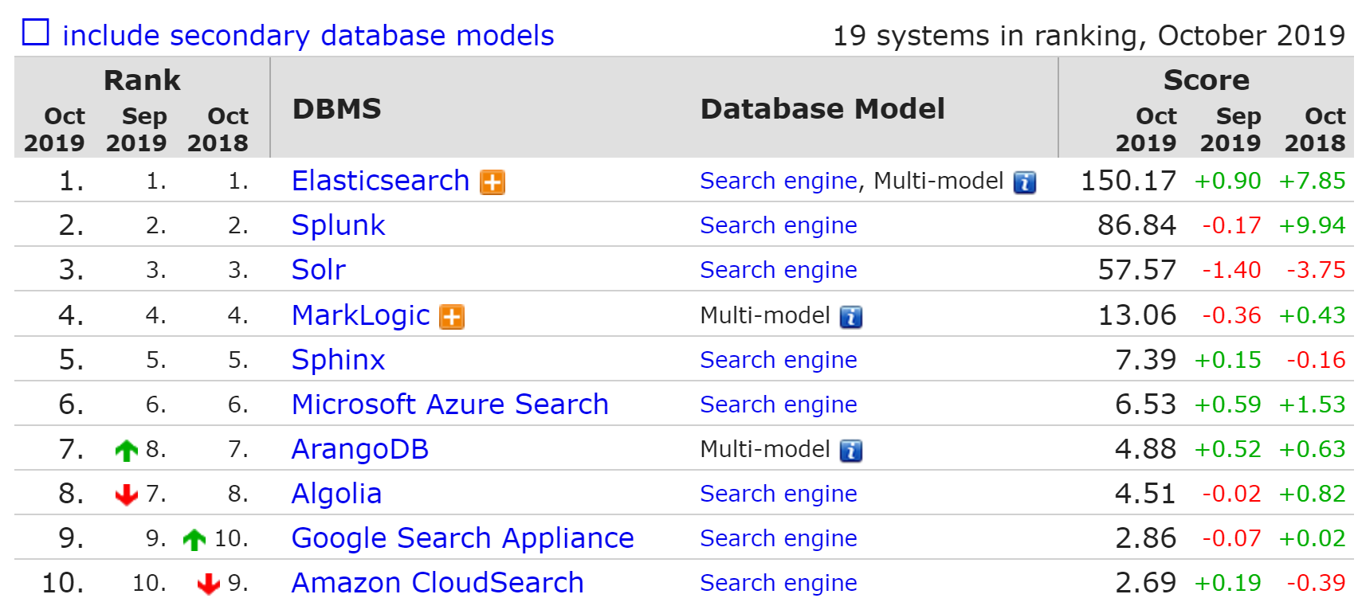
SEARCH ENGINES RANK

Slide 17

PRACTICE

Slide 18
WHEN TO USE SEARCH ENGINES
WHEN YOU NEED COMPLEX DOCUMENT QUERIES
E-COMMERCE (EBAY, EXPEDIA)
ANALYTICS (NETFLIX)
TEXT SEARCH (WIKIPEDIA)

Slide 19
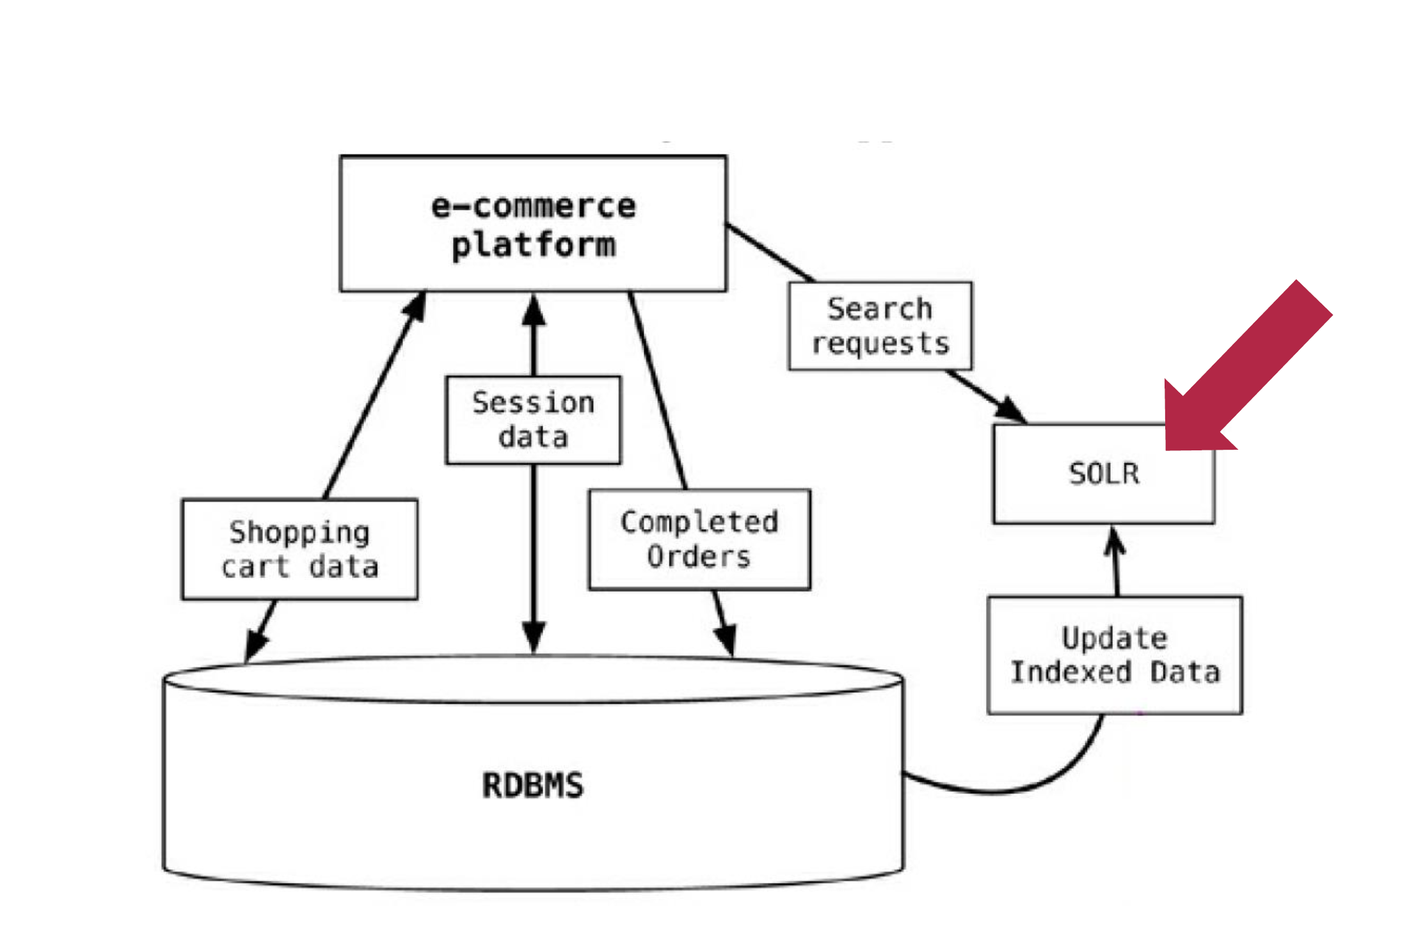
USECASE - ECOMMERCE

Slide 20
NOSQL CLASSIFICATION
KEY-VALUE STORES
TIME SERIES DBMS
DOCUMENT STORES
COLUMN STORES
SEARCH ENGINES
GRAPH DBMS

Slide 21
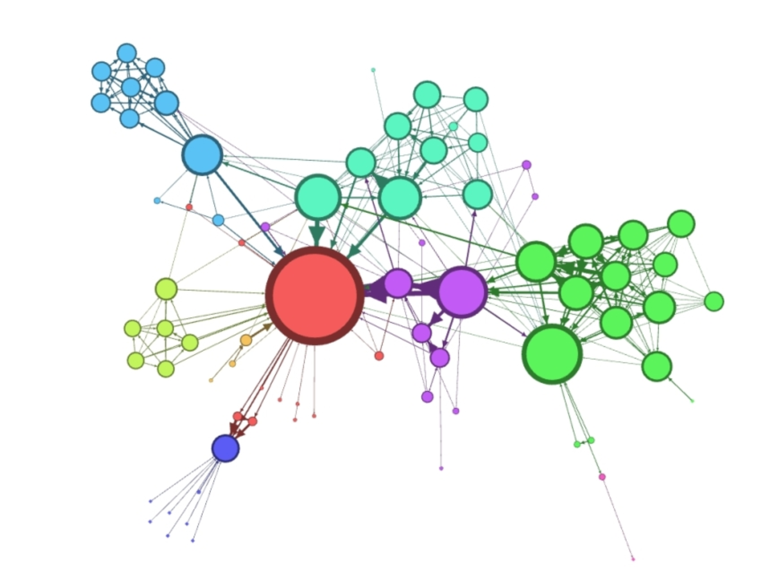
GRAPH DATA STRUCTURES

Slide 22

NETWORK SCIENCE
HOW KEVIN BACON CHANGED DATA SCIENCE ?

Slide 23


BOOKS

Slide 24
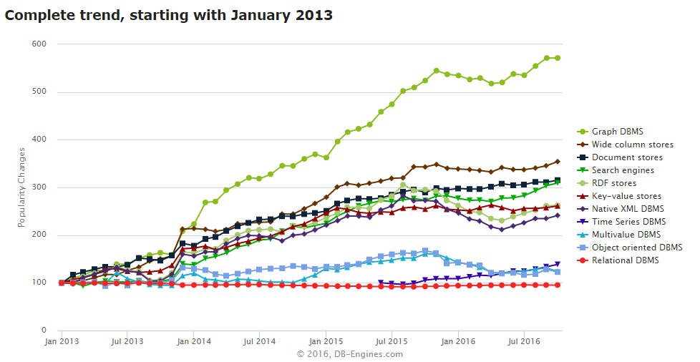
DATA SCIENCE
NEW
TYPE
ANALYTICS

Slide 25
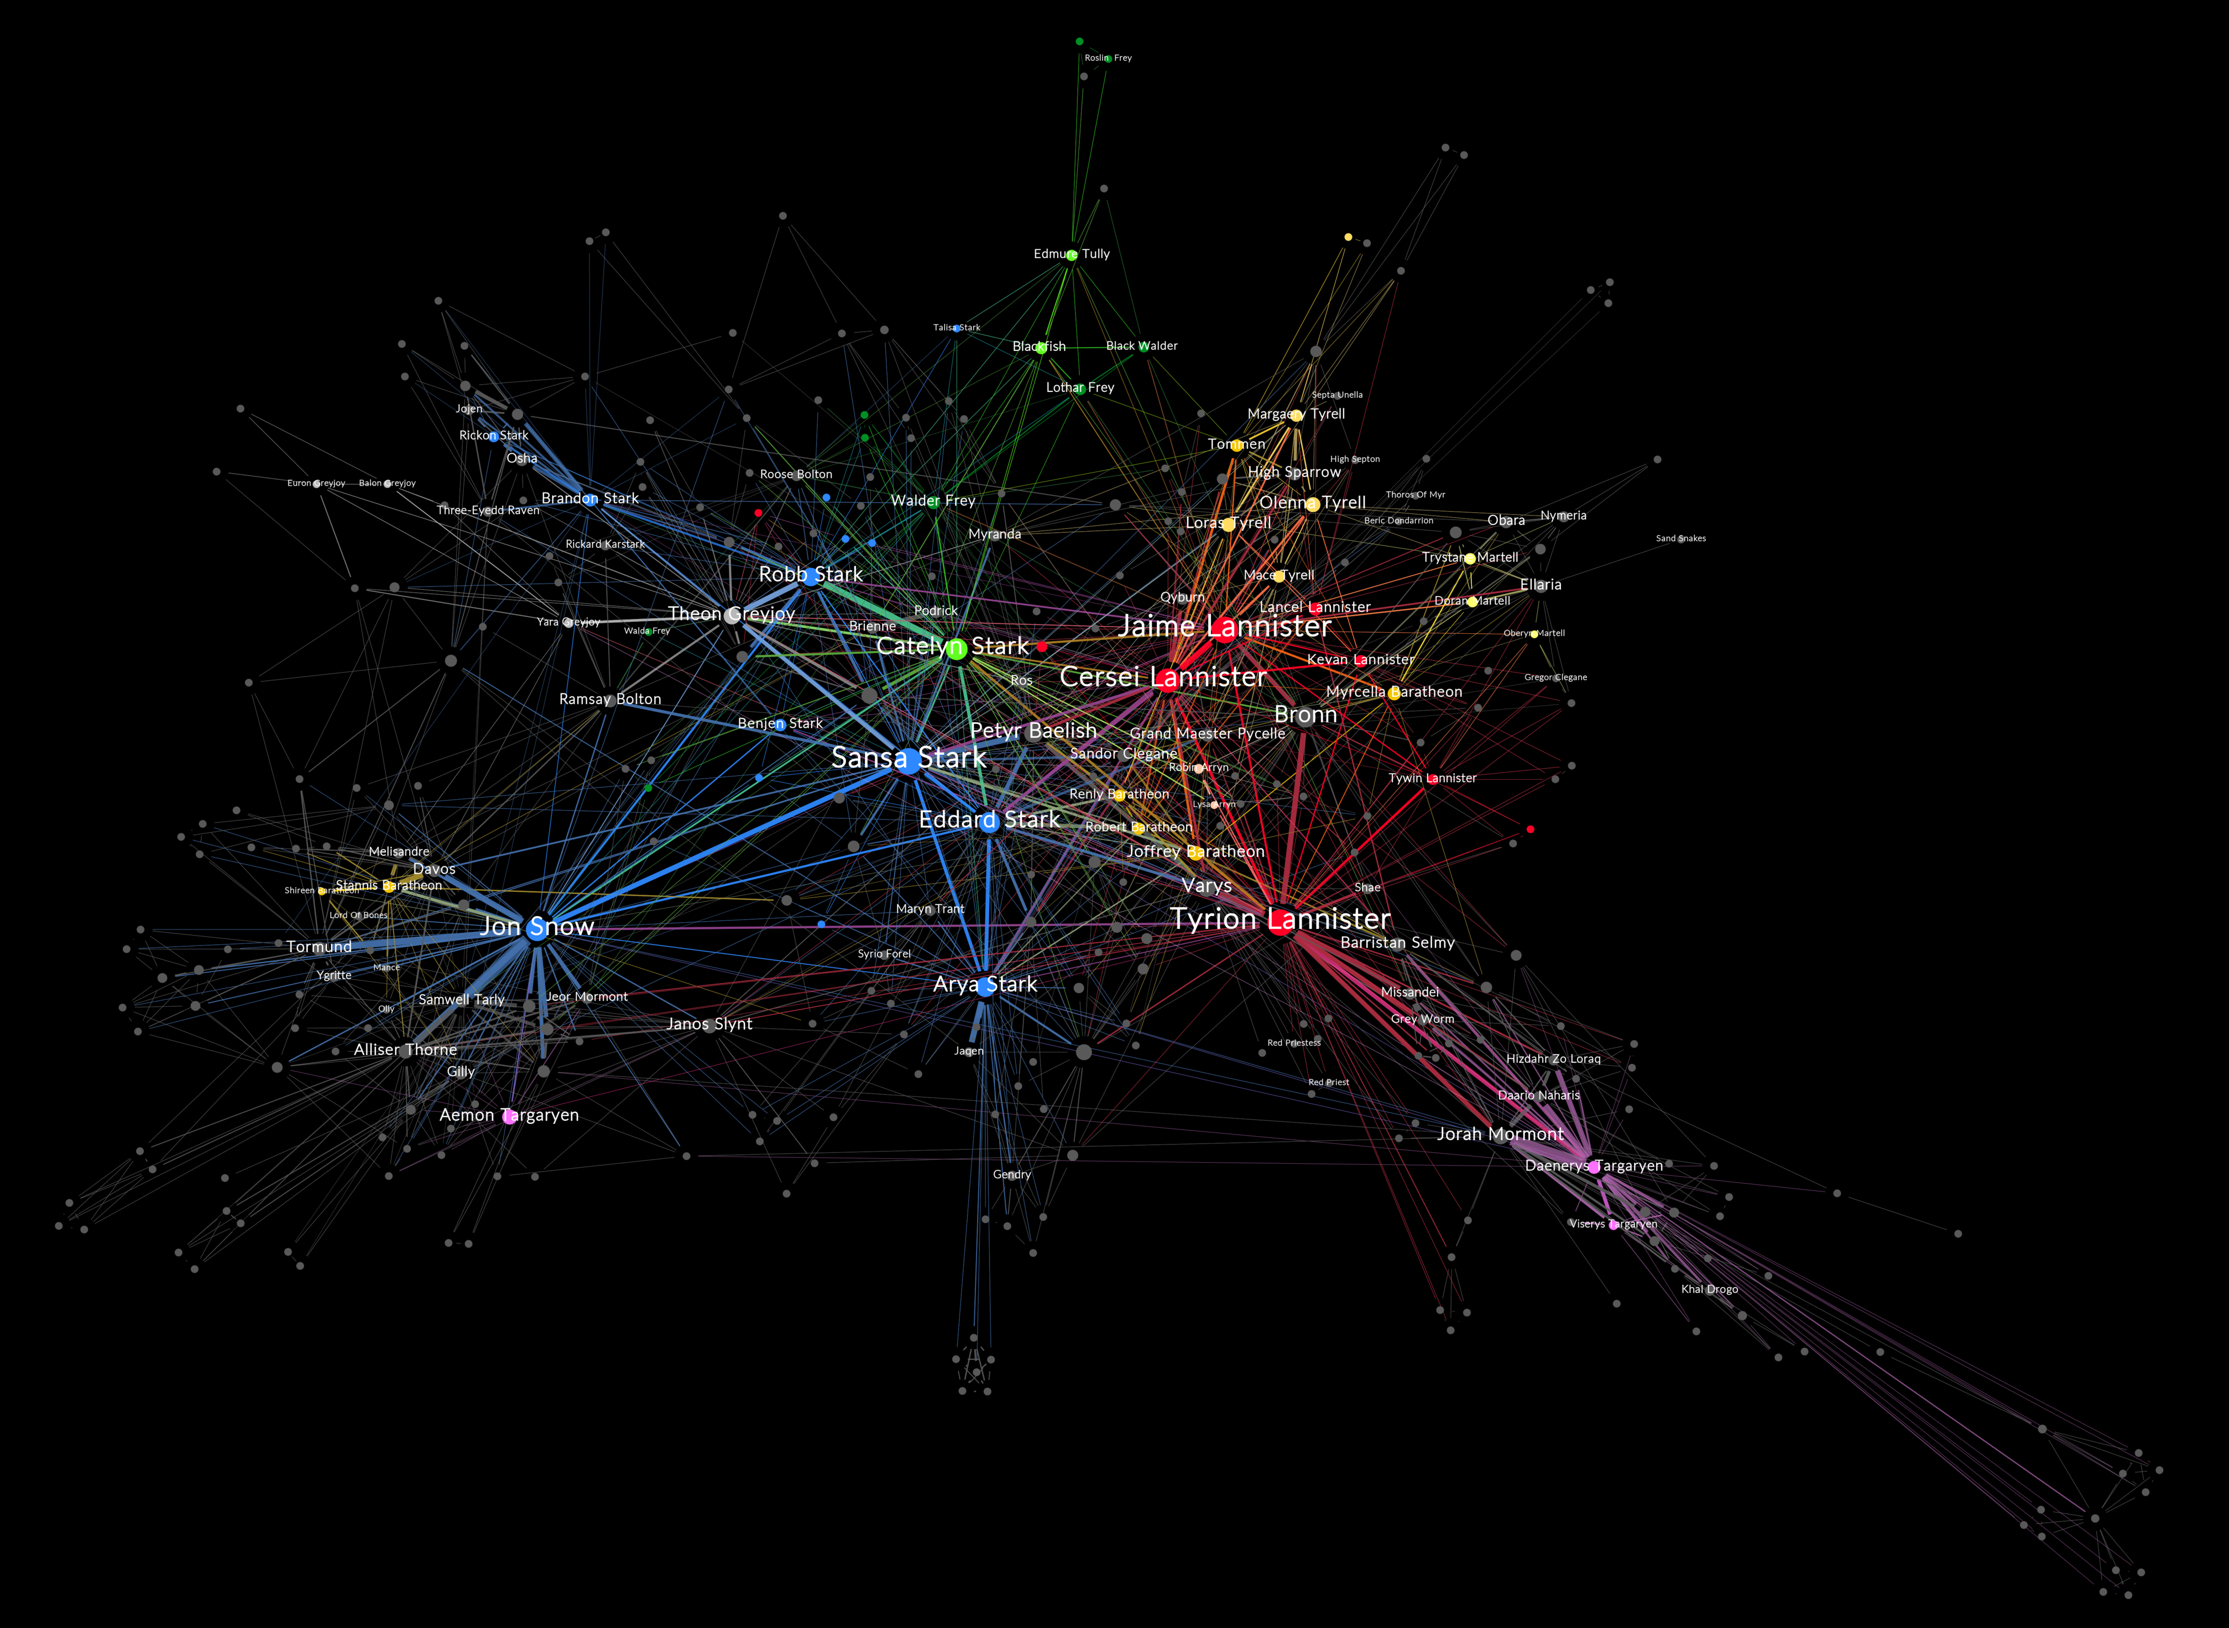
FEATURE ENGINEERING

Slide 26


ROBUSTNESS TESTING
Notes:
INSTEAD OF EXPLORING EMPIRICALLY

Slide 27
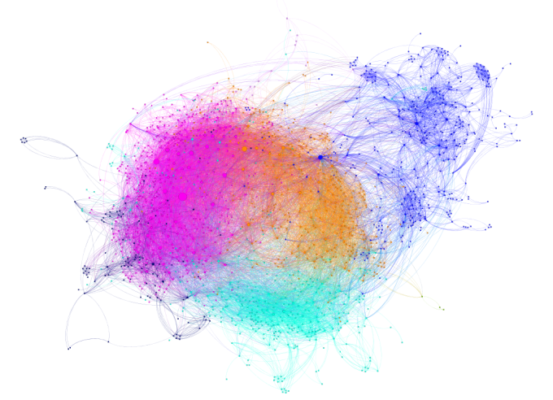
SEGMENTATION / FRAUD DETECTION

Slide 28
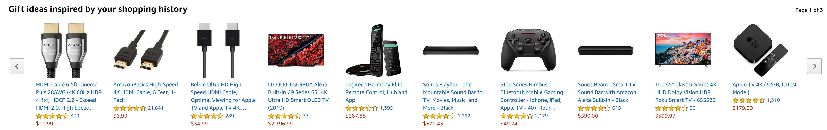
RECOMMENDATION ENGINE

Slide 29
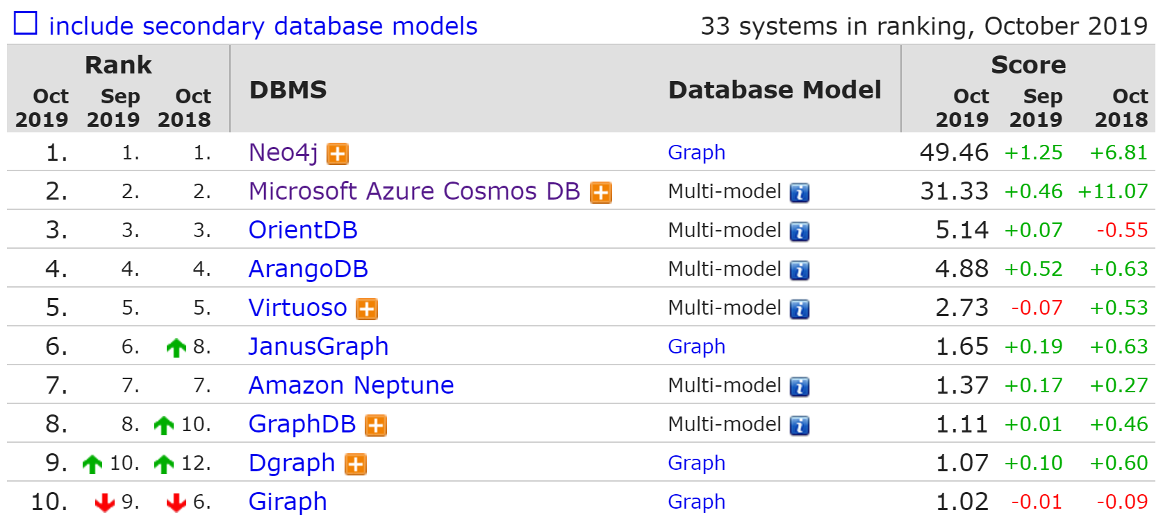
GRAPH DBMS RANK

Slide 30

PRACTICE

Slide 31
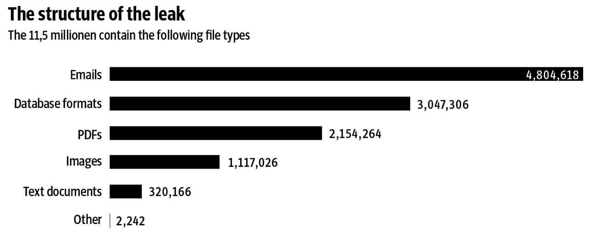
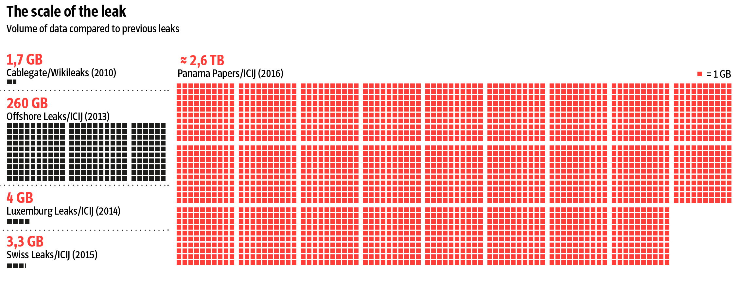
PANAMA PAPERS

Slide 32
PANAMA PAPERS – CLASSICAL FLOW
SCAN
OCR
DIGITAL TEXT
ETL
STRUCTURED DATA
RDBMS
SQL API
ANALYTICS
SOME STRUCTURED DATA
DATA MINING

Slide 33
WITH SEARCH ENGINE
Rich Document Parsing or NLP
Text Analysis
SCAN
SOLR +TIKA
DATA INGESTION
DATA INGESTION
DATA INGESTION
ANALYTICS
SEARCH ALGORITHM
SEARCH ALGORITHM
SEARCH ALGORITHM

Slide 34
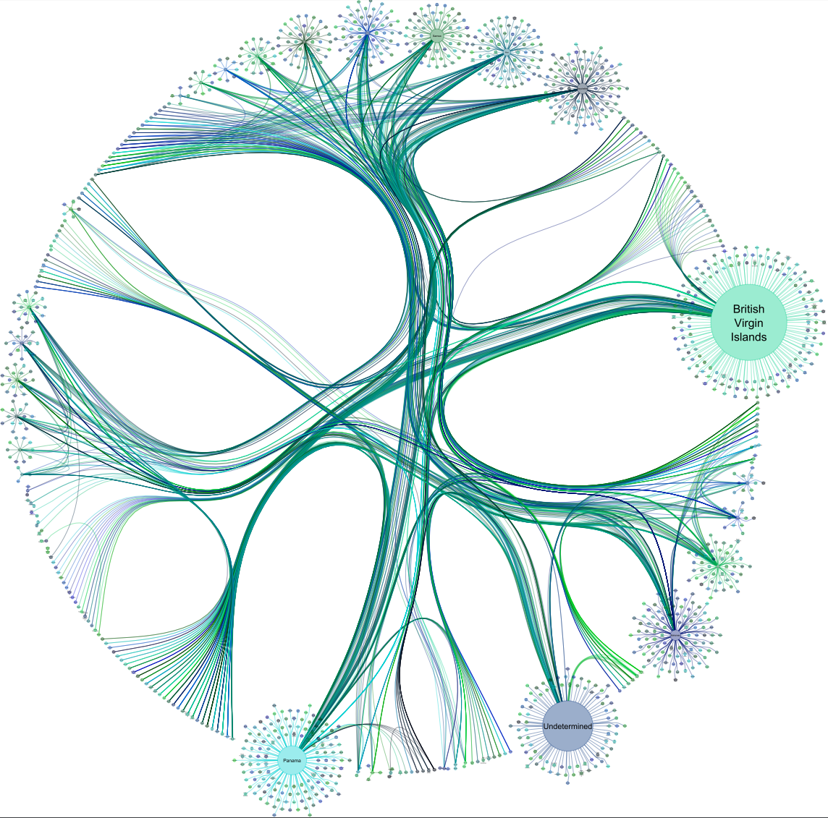

ADVANCED ANALYTICS
NEO4J
SOLR +TIKA
DATA INGESTION
DATA INGESTION
DATA INGESTION
ML
MODEL
SEARCH ALGORITHM
SEARCH ALGORITHM
SEARCH ALGORITHM

Slide 35
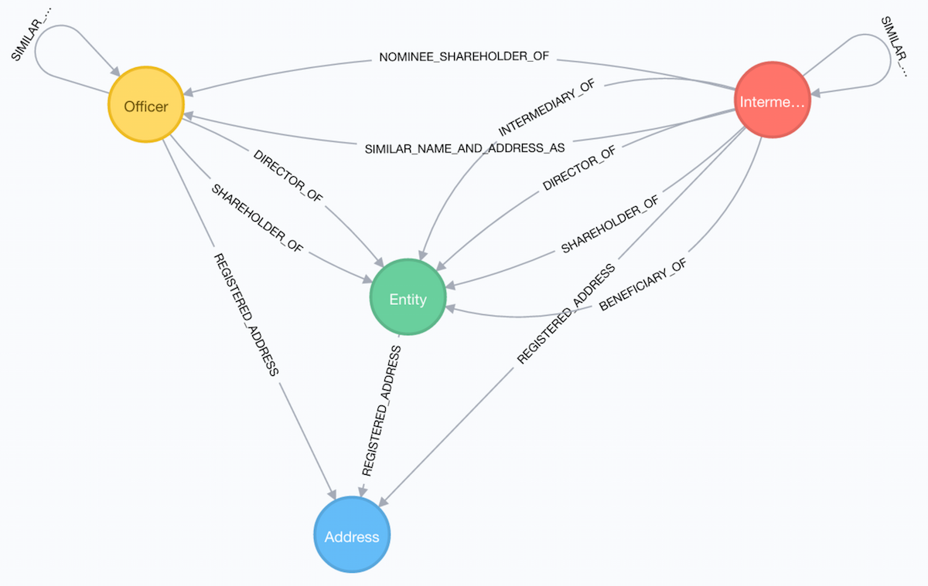
PANAMA PAPERS SCHEMA
Entity - The offshore legal entity. This could be a company, trust, foundation …
Officer - A person or company who plays a role in an offshore entity, such as beneficiary, director, or shareholder.
Intermediary - A go-between for someone seeking an offshore corporation and an offshore service provider — usually a law-firm or a middleman that asks an offshore service provider to create an offshore firm.
Address - The registered address

